Slide 1
The Triassic Geology at Highfield Farm
Ian Ladds, Tom Brown and David Briggs

Slide 2
Acknowledgements
The work described here has been done by members of the Nelson Rock and Mineral Club, as part of a project led by Ian Ladds.
The Club is extremely grateful for the access kindly given to the farm by the land owner, Richard Hunt. We thank him for his generosity.

Slide 3
Introduction
Aims and objectives:
To map and reinterpret the Triassic geology of the Highfield Farm area
Methods:
Field survey and mapping of rock strata using standard mapping techniques
Identification and tracing of faultlines
Systematic collection and recording of fossils
Use of GPS and GIS techniques to geolocate and map the data
Notes:
The study is being done using a variety of methods. Field work provides the basis for the study, and involves detailed examination of available rock sections, screes and landforms. All sites are geolocated using GPS and recorded in descriptive notes and, where appropriate, with photographs. Fossil finds are classified in the field and, to confirm classification, good, type specimens are photographed and collected. Where in-situ bedding features can be distinguished, measurements of dip and strike are made using an inclinometer and compass. All field records are collated in an Excel spreadsheet and mapping is done using a geographical information system (QGIS).

Slide 4
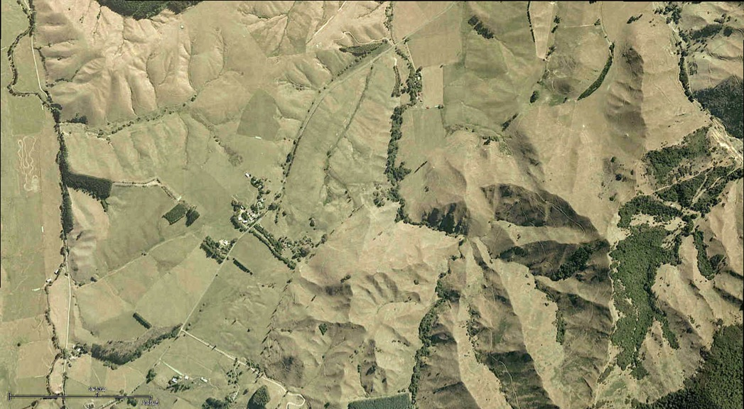
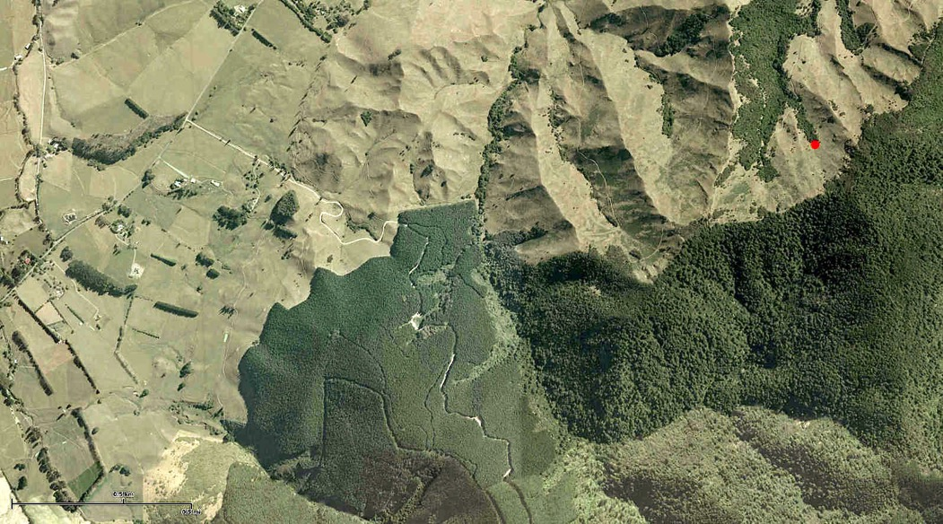
Highfield Farm
Gully A
Gully B
Ram Gully
88 Stream
Gully C
Notes:
The study area (Highfield Farm) lies on the west flank of the Richmond Hills, about 5 km south of Wakefield, near Nelson. The Eighty-Eight Stream runs through the farm, from south to north, and is joined by a series of right-bank tributaries, that have cut deep gullies into the hillside.

Slide 5
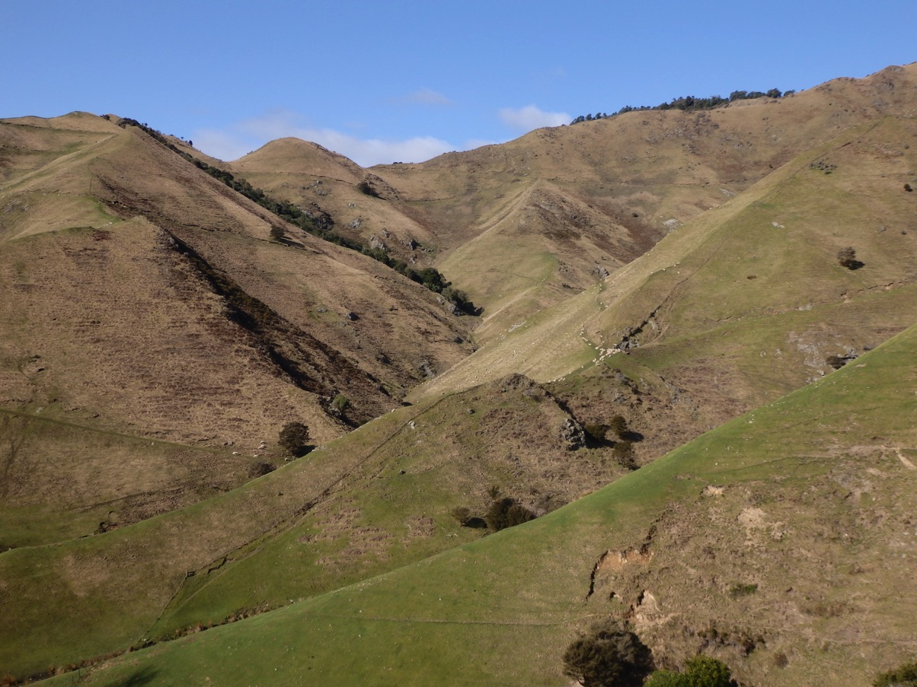
Highfield Farm: a view of gullies B and C
Notes:
The deep, V-shaped valleys have broadly straight slopes, at an angle of about 15-20º and are covered mainly by rough pasture, with residual areas of native bush. Outcrops are limited, and mainly occur as localised knolls and ridges on the more exposed south- and west-facing flanks.

Slide 6
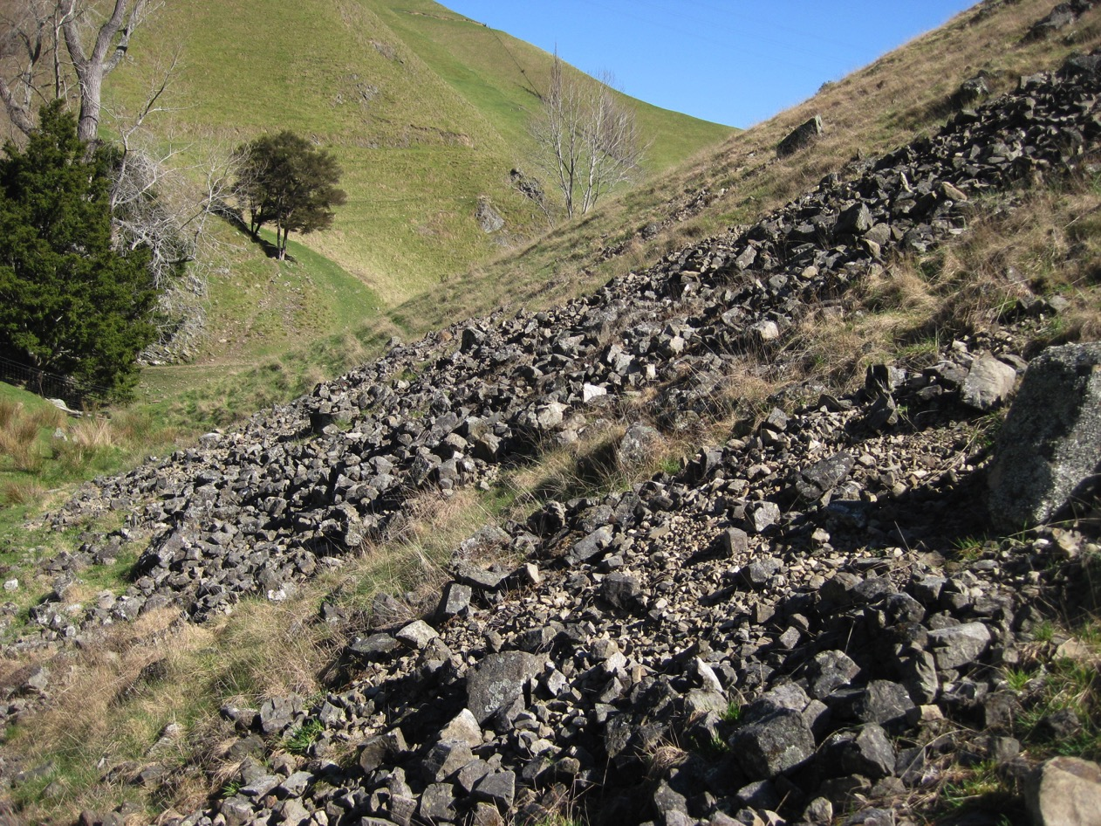
Scree slope, Highfield Farm, Gully A
Notes:
Screes and blockfields are common, but are generally limited in area and of shallow depth. Sorting is poor, and it appears that most of the debris has not travelled far downslope. Many of the screes have been supplemented by debris eroded from the access-tracks that have been cut through the farm. These, also, provide small sections in the bedrocks.

Slide 7
Previous studies
From Grant-Mackie 1984
Notes:
Several previous studies have been made in the Highfield and neignbouring areas (e.g. Campbell 1955, 1974; Grant Mackie 1984), which have described and mapped the geology. These show that the area mainly comprises a series of rocks of Triassic age, faulted against older Permian rocks to the south and east. Younger, Tertiary and Quaternary sediments fill the Waimea Valley, to the west. Five main stages within the early Triassic have been recognised. From oldest to youngest these are the Kaihikuan, Oretian, Otamitan, Warepan and Otapirian. An older Triassic formation, the Etalian, has been mapped elsewhere in the Nelson region, but have not previously been distinguished in the Highfield area. Prervious mapping at Highfield, as in the image shown here from work by Campbell, has been generalised and less detailed than we are doing in our study.
Useful previous references include:
Campbell, J.D. 1955 The Oretian stage of the New Zealand Triassic System. Transactions of the Royal Society of New Zealand 82 (5), 1033-1047.
Campbell, J.D. 1974 Biostratigraphy and structure of Richmond Group rocks in the Wairoa River-Mount Heslington area, Nelson. New Zealand Journal of Geology and Geophysics 17 (1), 41-62.
Grant-Mackie, J.A. New Zealand Warepan (Upper Triassic) sequences – Murihiku Supergroup of South Island. Journal of the Royal Society of New Zealand 14 (2), 175-206.

Slide 8
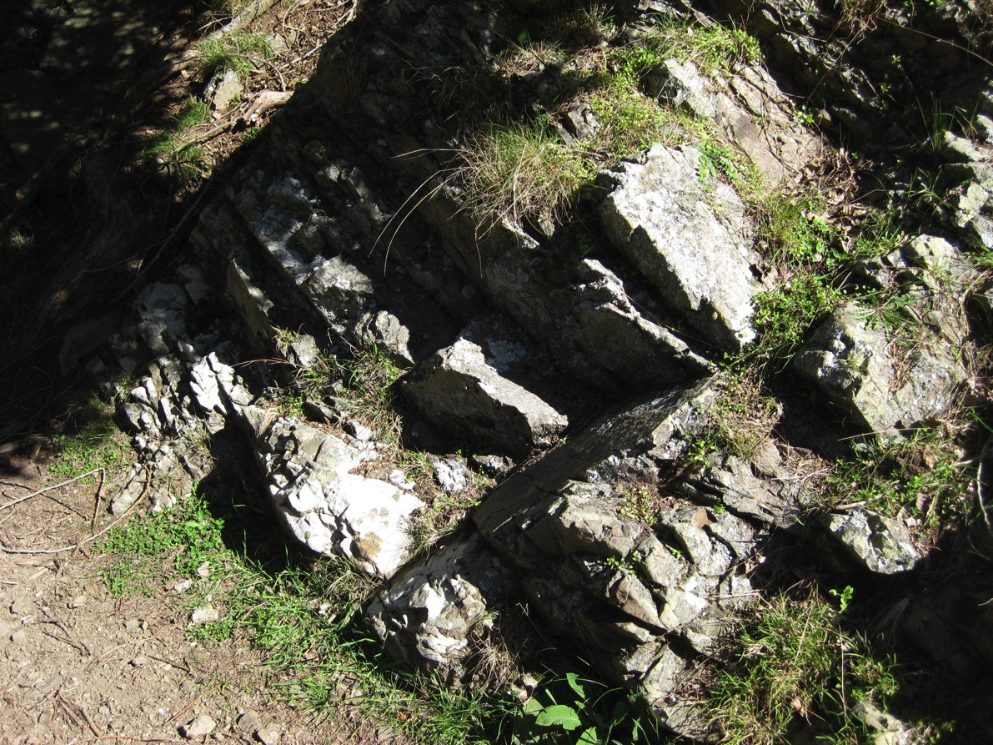
Rock types at Highfield
Notes:
Most of the Triassic bedrocks at Highfield consist of fine-medium sandstones and siltstones, with smaller quantities of coarse sandstone, gritstone and conglomerate, and mudstone. Some of the rocks are tuffaceous, and within the conglomerates occasional pebbles of granite can be found. The rocks are heavily jointed, and bedding is usually indistinct (as in the example shown here); bedding structures, such as sole marks, ripples or evidence of graded bedding are scarce.

Slide 9
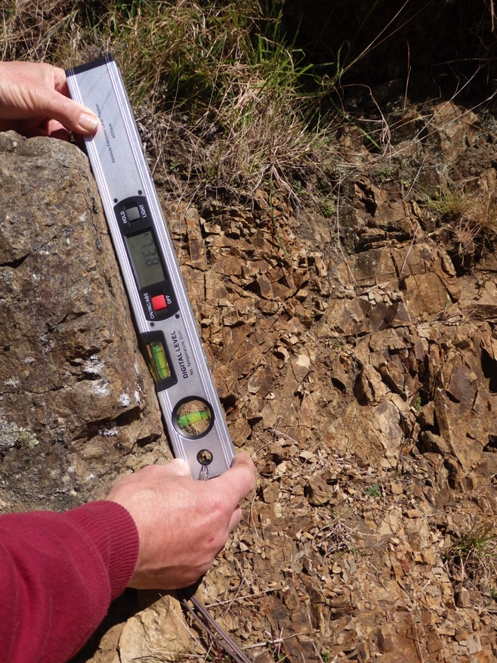
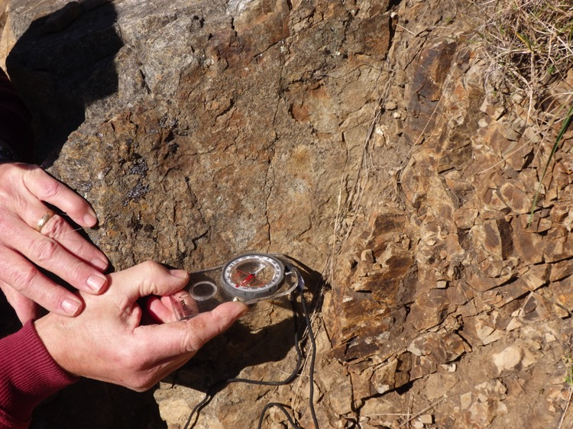
Measuring dip and strike
Dip is measured as the inclination (degrees from horizontal) of the steepest line of dip in the rock.
Strike is measured as the horizontal compass bearing (azimuth) at right angles to the dip.
Notes:
Measurement of dip and strike is vital in attempting to trace and map the rocks, but measurement is hampered by difficulties in distinguishing the true bedding planes in the rocks due to the heavy jointing and poorly defined bedding structures. Where dips can be measured, they are usually relatively high (>60º).

Slide 10
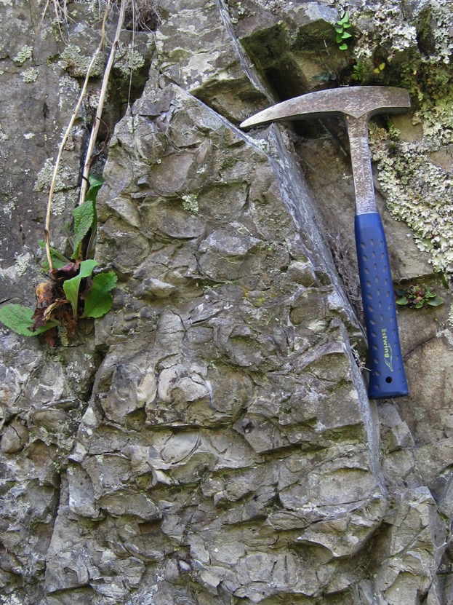
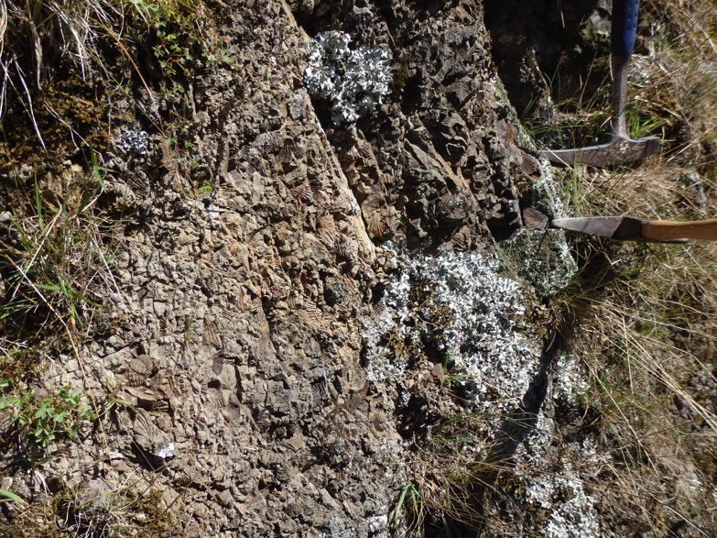
Fossils and bedding planes
Notes:
Some of the best indications of the bedding are often given by fossils, especially where these occur in clearly defined fossil beds. The left photograph shows a bed of Manticula problematica; the right photograph shows a bed filled with Monotis sp.

Slide 11
Fossils and bedding
Notes:
Clues to the bedding can also be found where fossils are more sparsely distributed. Here, Manticula problematica fossils have been cut by the joint surface, and form small, elongated depressions, running in lines from the top to the bottom of the photograph. They show that the bedding here runs steeply into the outcrop; the dashed white line depicts the strike direction.

Slide 12
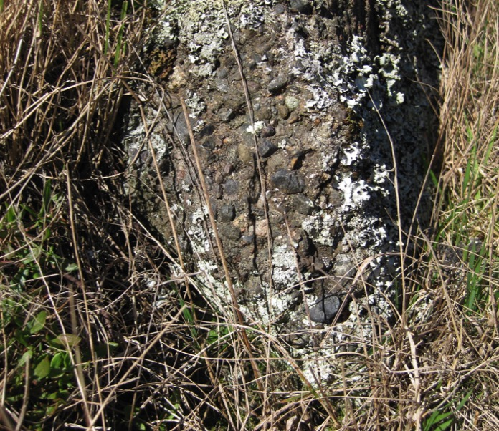
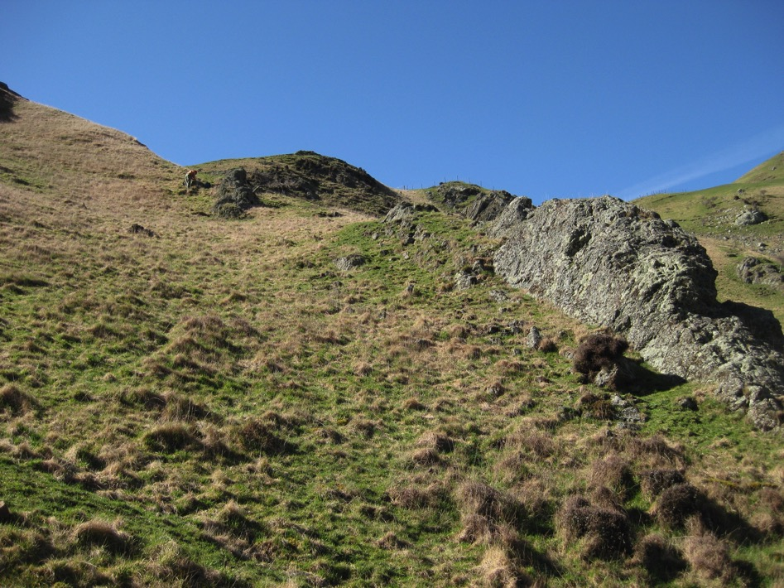
Lithology and bedding
Notes:
Clues to the bedding are also occasionally given by changes in lithology. Here, a rocky outcrop, formed of sandstone, can be traced up a slope, with an apparent dip shown by the arrow. Confirmation is provided by a bed of pebbly conglomerate that runs parallel to the outcrop, as indicated by the dotted line.

Slide 13
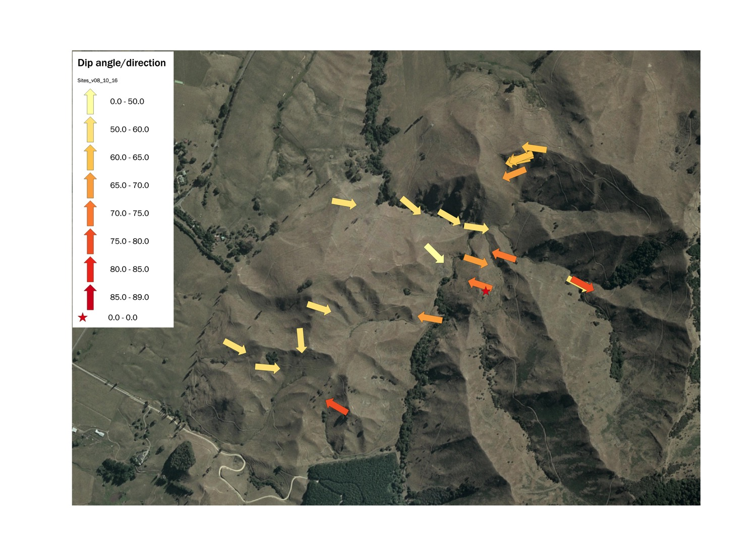
Dip and strike at Highfield
?
Notes:
Measurements of dip and strike at Highfield show considerable variability. To the west, the rocks dip eastwards at angles of 60-70º. To the immediate west of this zone the dip is reversed, and the rocks dip more steeply (70-90º) to the west. Few measurements have yet been made in the eastern area of the farm, but those that have suggest another reversal, with dips to the east-south-east. The overall pattern hints at the presence of at least one major fold, in the form of a syncline running south-west to north-east through the area; the white dashed line shows the inferred axis of the syncline. An anticline, or perhaps a fault, may also run along the line indicated by the yellow dots.

Slide 14
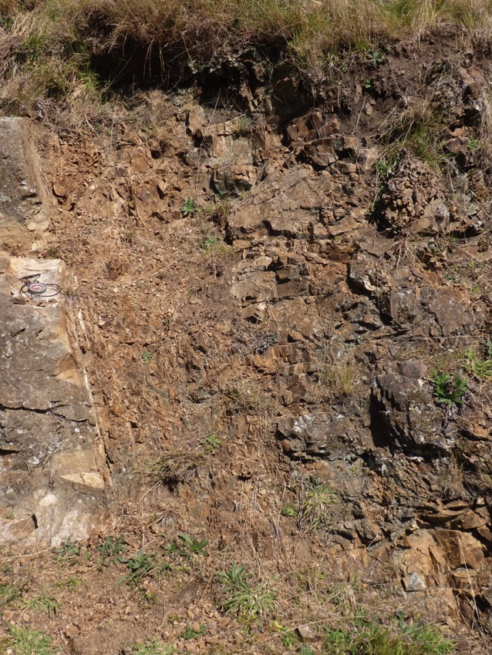
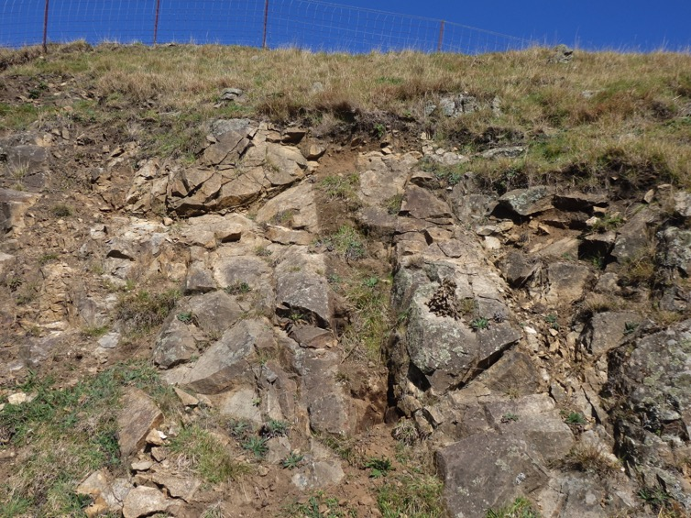
Faulting at Highfield
Notes:
Faults are also evident at Highfield, as illustrated in the photographs here. Identifying the throw (i,.e. direction of movement) of the faults is difficult, because they usually coincide with bedding planes, so there is little variation in rock type from one side to the other of the fault, and no obvious disjuncton in the bedding. Typically, the faults are also narrow (1-2 metres in breadth) and filled with crushed rock, aligned parallel to the fault (see left photograph). In most cases, several faults occur together, as parallel clusters, suggesting that movement occurred not as a single movement along a major faultline, but as a series of separate movements along a zone of faulting.

Slide 15
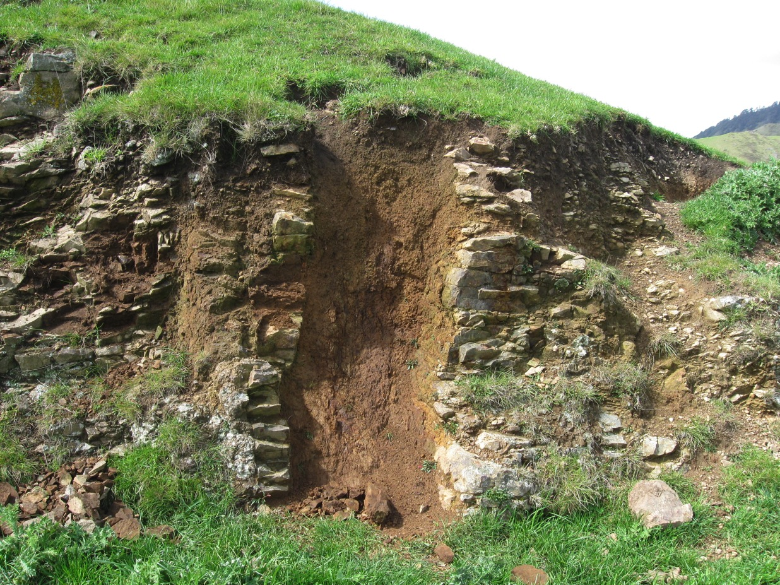
Fault or Gull
Notes:
Not all the features that look like faults may be traditional thrust faults. Some, such as the feature here, are filled with fine, weathered material, little different from the hillwash that now covers the slopes. One possibility is that they are ‘gulls’. These are tensional features, caused by opening up of joints or bedding planes when pressure release during valley-cutting allows the rocks to creep downslope. Examples of gulling have not been reported in New Zealand before, but they are relatively common in many parts of the UK. More research is needed to confirm the origin of these features.

Slide 16
Tracing faults
Crush zone
Knick
?Crush zone
Dog-leg in stream
Hummocky knoll
Fault
Knicks
Knicks
N
Notes:
The faults in this area appear to have only a small influence on the landscape. This is probably mainly because they run along bedding planes and thus do not bring together rocks of markedly different character, which erode at different rates. For this reason, tracing faults across the landscape is not easy. Clues can be found, however, in features such as knicks and localised saddles in ridgelines, areas of finely broken scree which may indicate crush zones, unexpected changes in stream direction, and areas of hummocky ground which suggest localised displacement. Based on these features, two converging faultlines (red, dashed lines) can be postulated in the area shown here. (Note that north on this image is to the left of the slide)

Slide 17
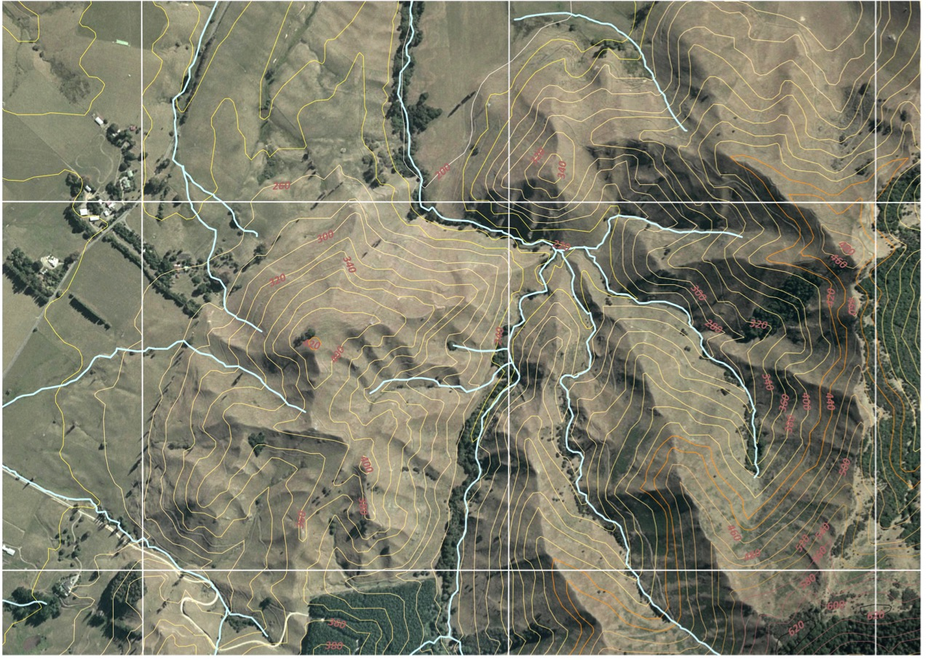
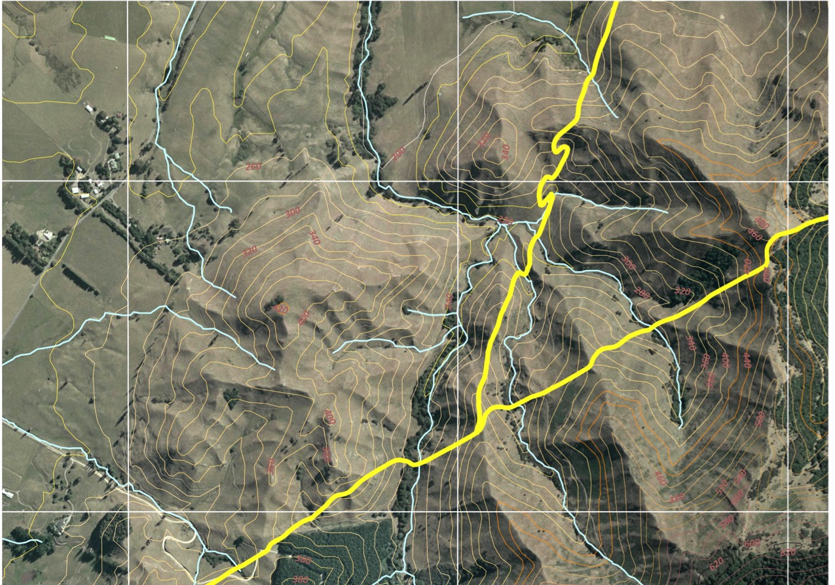
Faults at Highfield
N
79º, 200º
75º
240º
Notes:
Using GIS (geographical information systems) more detailed predictions of faultlines can be made. Here we have used software that projects a surface plane through the landscape. We feed in the dip and direction of each of the faults at locations where we can measure them (shown by the data next to the write arrows). The software then extrapolates the line of the fault both vertically and horizontally, and calculates where it will cut the land surface. The predicted lines are shown in yellow on the map. They run almost perfectly through all the features that we identified as possible clues to the fault. (Note that this image has been reorientated compared to the previous one, with north at the top).

Slide 18
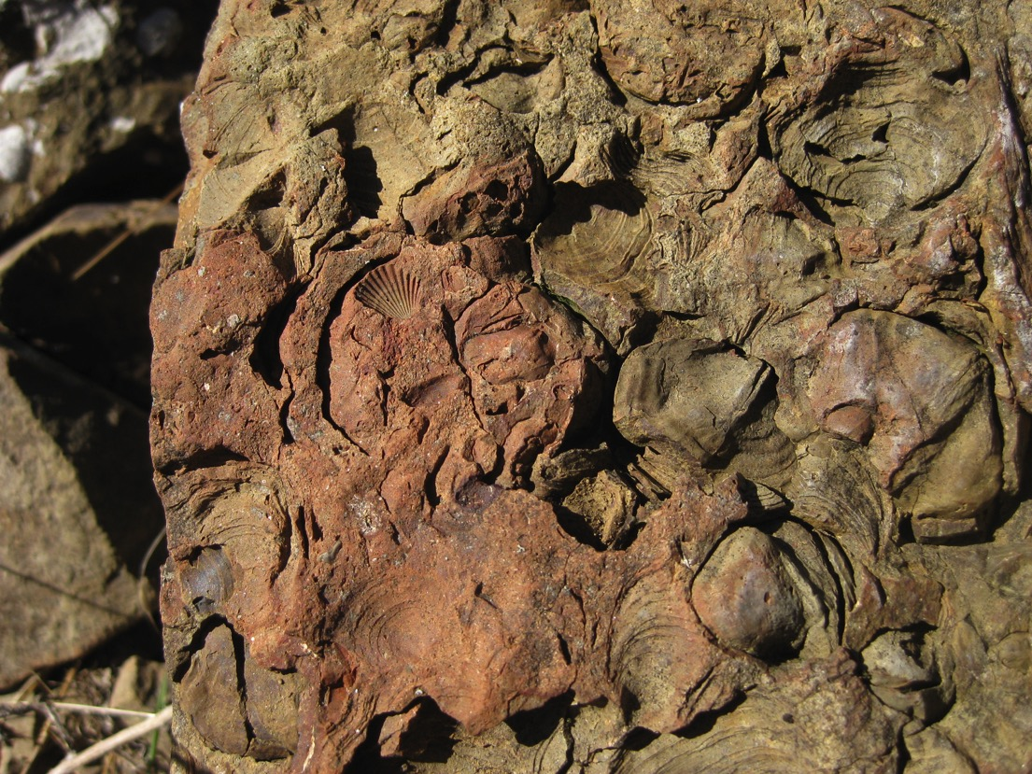
Fossils
Notes:
Fossils provide some of the most important evidence we can use in mapping the geology – though of course they are only likely to be present in sedimentary rocks. As already mentioned, they can help to show the line of the bedding plane, but also give an indication of the age of the rocks and the environment of deposition. By tracing and mapping fossil species, we can also correlate the rocks between different outcrops, and work out the stratigraphy.

Slide 19
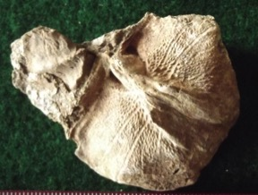
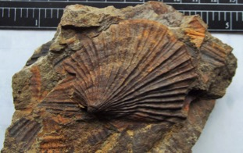
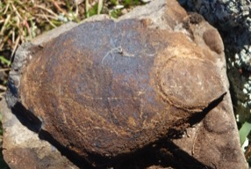
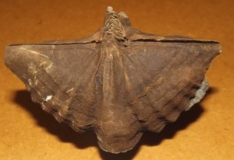
Key fossil species
Otapirian
(youngest)
Clavigera tumida
Warepan
Monotis sp.
Manticula problematica
Otamitan
Oxycolpella wreyi (probably not)
Oretian
Kaihikuan
(oldest)
Alipunctifera kaihikuana
Notes:
The five stages of the Triassic recognised in the Highfield area are characterised by a somewhat different fossil assemblages. The assemblages also include specific fossil species restricted to that stage. Finding these fossils thus provides strong evidence of the age of the rocks. Fossils can only be interpreted, however, if they can be accurately identified, and that can be difficult both because good specimens of the fossils may be hard to find, and good reference materials, with which to compare the finds, are not always available. Here we show photos of four of the main indicator fossils for the Triassic, found at Highfield – but as yet we don’t have a good specimen to show of the Oretian indicator, Oxycolpella wreyi.

Slide 20
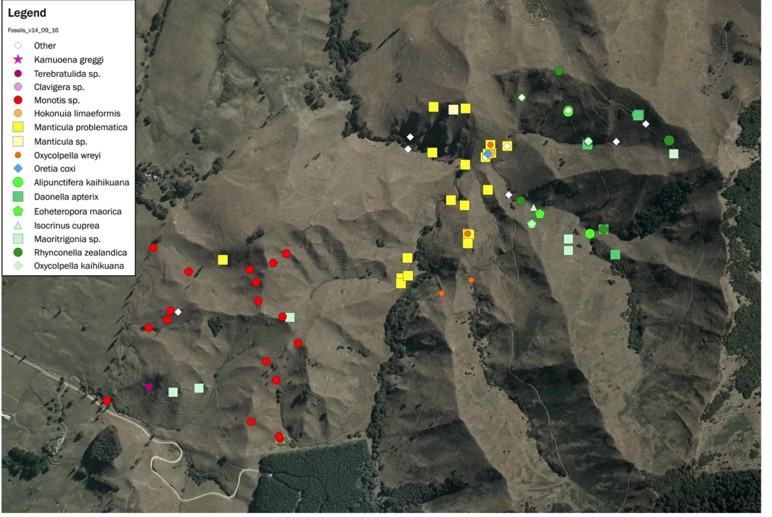
Fossil distribution, Highfield
Age of first occurrence
Otapirian/ Warepan
Otamitan
Oretian
Kaihikuan
Notes:
Collection to date has produced a large fossil fauna, comprising at least thirty different species. These include brachiopods, bivalves, crinoids, bryozoa, anthozoa, ammonoids and plant fragments. Identification of the fossils, and confirmation of the identifications, continues, and a substantial number of finds still remain to be classified. Saeveral of the finds (e.g. the anthozoa) are unusual, and have been reported to the GNS Fossil Record Electronic Database (FRED).
Mapping of the fossils shows a clear pattern, reflecting the different age of the rock strata. Three different zones are evident, indicated by the green symbols (Kaihikuan), the yellow (Manticula problematica, indicative of the Otamitan), and the red circles (Monotis sp., indicative of the Warepan). A fourth zone may exist in the south-west, beyond the limits of the Monotis specimens, and there is a possible fifth zone (indicated by the large red circles) where Oxycolpella wreyi and other possible Oretian fossils have been found, intermixed with Otamitan fossils. More research is needed to unravel the sequence in this area. More field work s also needed to fill in the large gaps in the fossil distribution down the west side of the area.

Slide 21
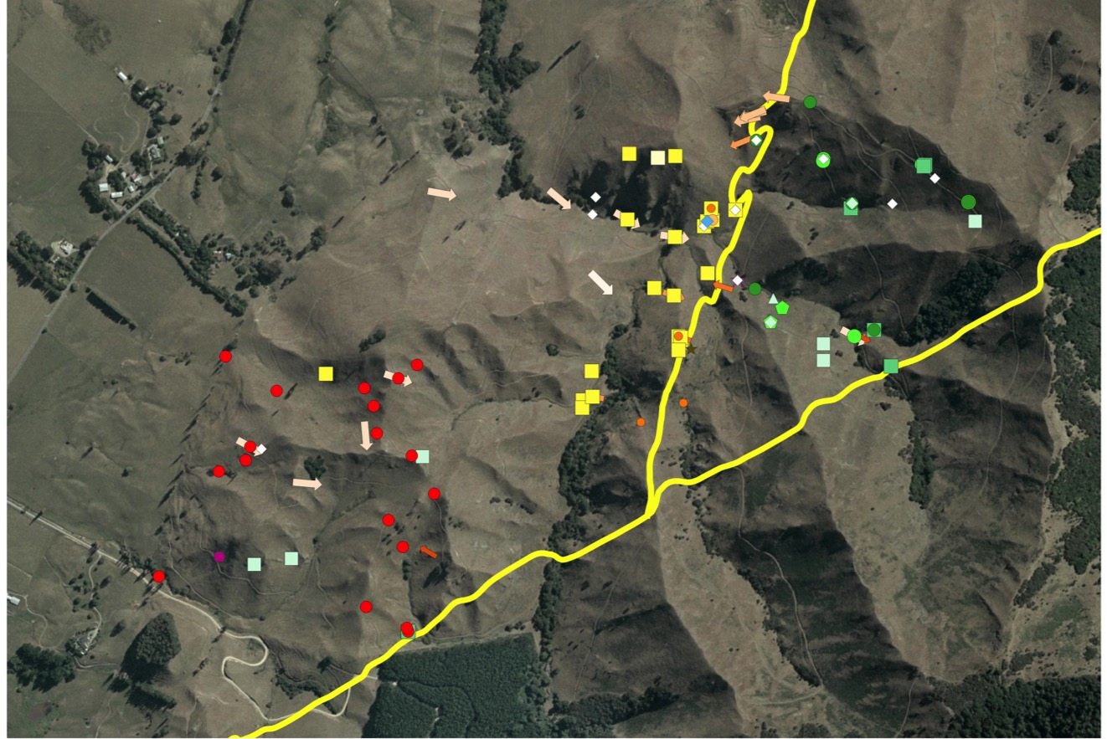
Putting it all together
Notes:
Using GIS, we can now start to put together the various lines of evidence from our work. Here, we have overlaid the fault-lines and the measurements of dip and strike onto the fossil map. The results are broadly consistent. The faults make a clear demarcation between the Kaihikuan (green) and Otamitan (yellow) fossils, and also between all the Triassic fossils found and the largely unfossiliferous (Permian) rocks to the south. The dips of the rocks also seem consistent. Note that the westward dipping band of rocks lies just to the west of one of the faults – perhaps indicating that the rocks here have been dragged up and folded during faulting.

Slide 22
Putting it all together
Highfield Fault
Oretian?
Kaiahikuan
Post-Triassic
T3
Otamitan
88 Fault
Permian
T2
T1
Warepan
Otapirian
Notes:
We can now start to interpret the evidence. Here, we have added tentative boundaries for the main Triassic stages (dashed white lines). Kaihikuan rocks appear to be limited to the area between the two faults – the Highfield and Eighty Eight Fault, and appears to be a block of older Triassic rocks, uplifted during faulting. The younger Triassic rocks (Oretian, Otamitan, Warepan and Otapirian) occur to the west of the faultlines, and – from their dip and distribution – appear to form a narrow, tightly folded syncline, treending south-west to north-east.
Several aspects of this interpretation remain tentative. For example, the distribution of the Oretian rocks is largely speculative, and needs to be confirmed by more fossil finds. Thed Otapirian rocks, which form the core of the syncline in the south-west, also require more analysis. More recent work has also both confirmed and challenged this interpretation. In the red box (lower centre), for example, we show locations for four additional finds of the bivalve, Manticula problematica, which is indicative of Otamitan rocks. Three of these fit nicely within the mapped Otamitan area, but the southernmost locality lies south of the faultine in the area we have mapped as Permian. Have we got the fault in the wrong place here? Or have the samples of M. problematica perhaps moved downslope in the screes, and strayed into the Permian zone?

Slide 23
Putting it all together
Permian
Otamitan
88 Fault
Kaihikuan
Oretian?
Oretian?
Highfield Fault
Kaiahikuan
Post-Triassic
T3
Permian
Otamitan
Otamitan
Kaihikuan
Oretian?
Highfield Fault
88 Fault
Permian
T2
T1
Warepan
Otapirian
Otapirian
Warepan
Permian
Otamitan
Oretian?
88Fault
Notes:
Lastly, we can try and deduce the stratigraphy of the rocks in the area, in cross-section. Here we show three cross-sections, from north to south in the farm. Permian rocks occur in the east, over-riding the 88 Fault, presumably as a result of compression and uplift. Between this and the Highfield Fault is a block of Triassic Kaihikuan rocks, which seems to have been pushed up during faulting. Further west is a syncline, apparently created by the compression associated with movement of the rocks to the east.

Slide 24
Conclusions
As a result of careful study, using different techniques, the history of the rocks at Highfield are gradually becoming clear.
But there are many questions that still need to be solved, and much more work that needs to be done.

